Slide 1

Decentralized exchange
FPT UNIVERSITY FUNIX EDUCATION
MENTOR IMPLEMENTER
NGUYỄN THÁI PHƯƠNG NGUYỄN PHÚ HƯNG
An exchange that connects tokens on the same blockchain network.

Slide 2

CONTENTS
Introduction
Problem Statement
Solution
Implementation
Blockchain & Smart Contracts
User Interface
Future Extensions
Demonstration

Slide 3

1. introduction

Slide 4
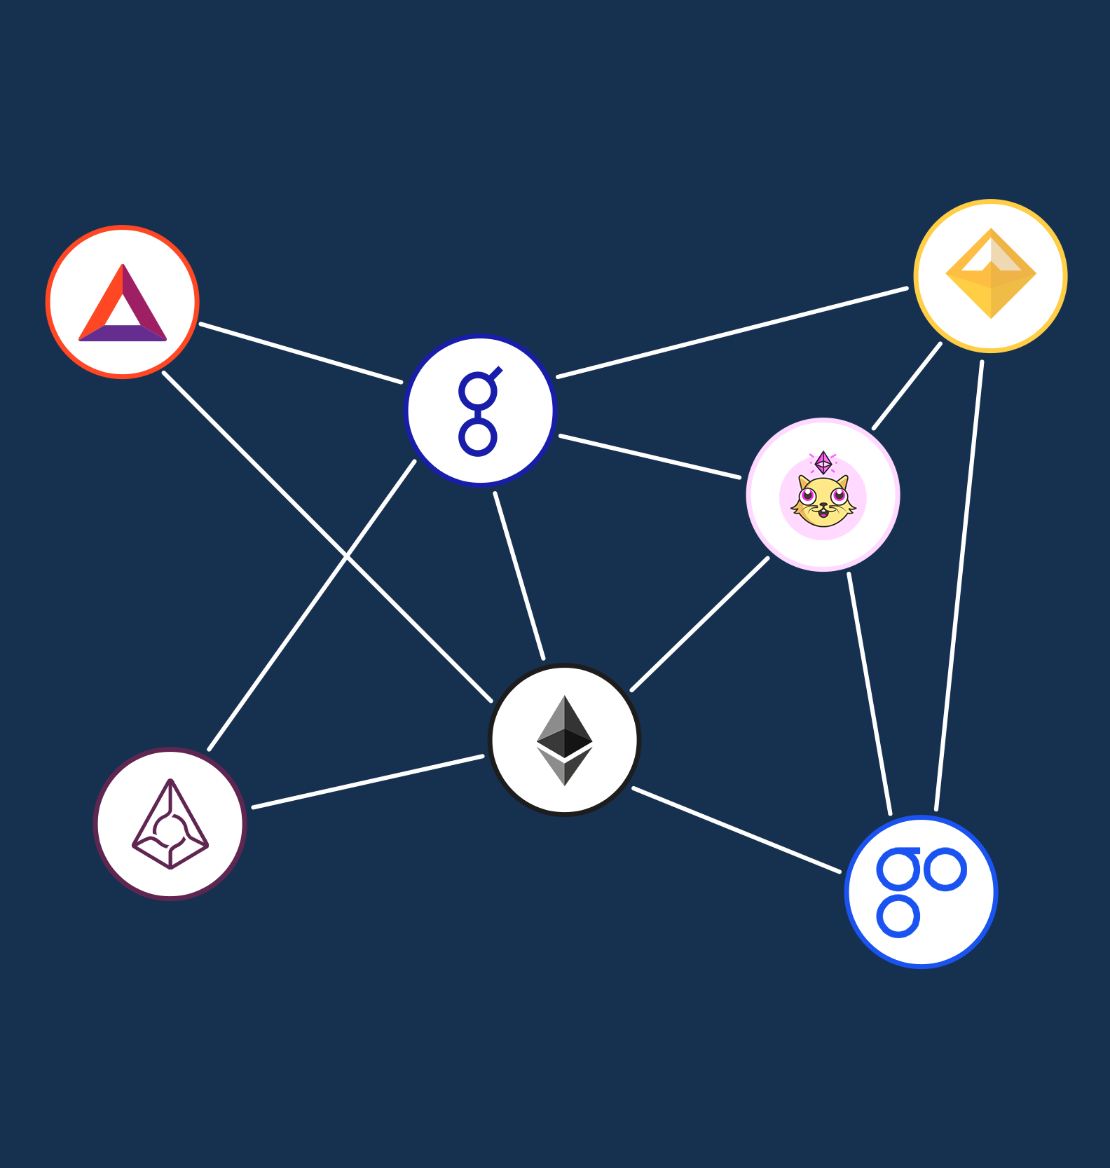
1.1. Problem statements
Many tokens exist on the Ethereum network.
However, some went forsaken or stayed on low liquidity.
Inconvenient trading
The issue of trusting a third party
Notes:
Tím: Augur (REP)
Chữ g: Golem (GNT)

Slide 5

1.2. Solution
A decentralized exchange that:
Connects tokens on the network
Supports exchanging and transferring tokens
Provides methods to import and display wallets

Slide 6
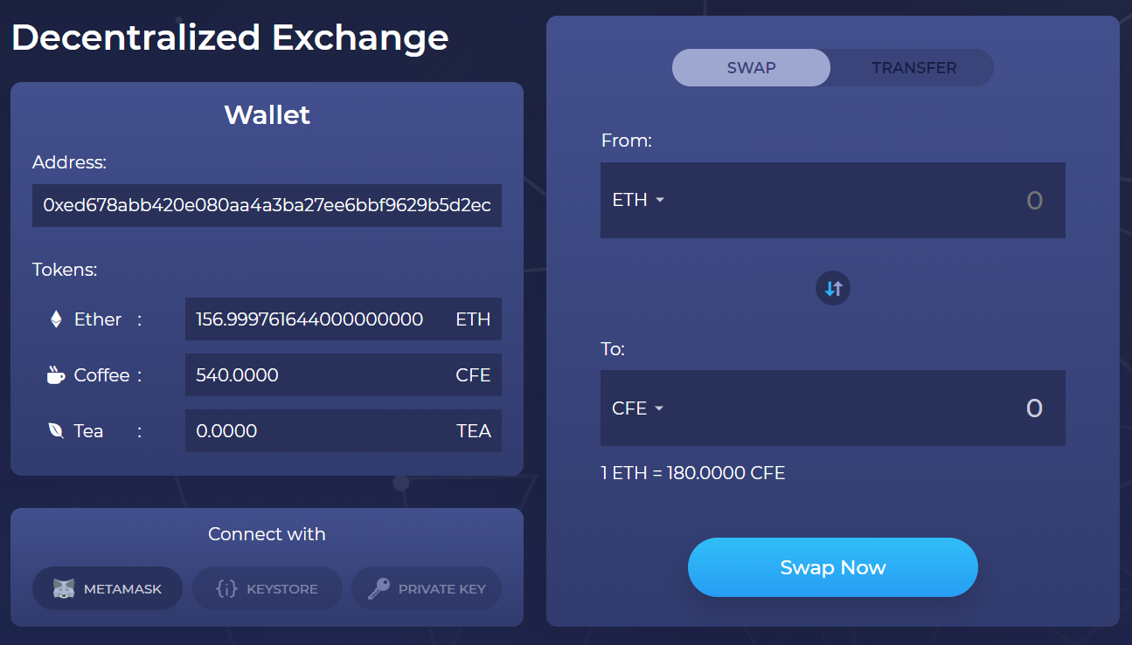
1.2. Solution

Slide 7
2. implementation

Slide 8
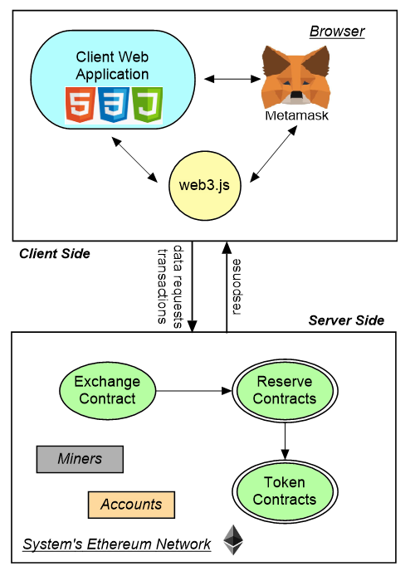
2. Implementation
The system consists of:
A blockchain network as back-end
A web application as user interface
Means of communication between the two

Slide 9
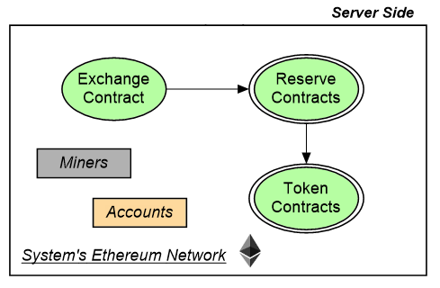
2.1. server-side: blockchain & smart contracts
Blockchain network: Ethereum
Contracts:
Token: Contains logics for different tokens
Reserve: Stores and exchanges its token with Ether
Exchange: Connects users and different Reserves/Tokens
Node: Geth node
An end-point of the blockchain network to connect to the web client

Slide 10
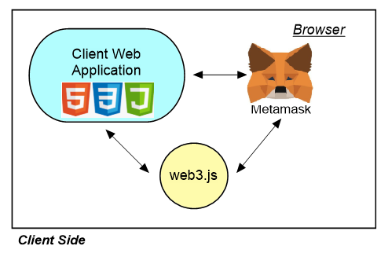
2.2. client-side: user interface
Web interface: jQuery on Node.js
Metamask:
Helps import accounts
Verifies and signs transactions
web3.js:
Interacts with the Ethereum node
Gets data and sends transactions

Slide 11
3. Future extensions

Slide 12
FUTURE EXTENSIONS
Creating wallets
Users can create new wallets in the network.
The balances are initialized to 0.
Viewing transactions
Users can view history of transactions.
Each transaction is showed with token, amount, transaction fees, transactions status, processing time.

Slide 13
4. demonstration

